Slide 1
SULPHUR ISOTOPES
ASSOCIATED WITH
EVAPORITES
To be used only for scholarly purposes,
consistent with “fair use” as prescribed in the U.S
B. Charlotte Schreiber
Department of Earth & Space Sciences
University of Washington
Seattle WA

Slide 2
Isotopes of the Naturally Existing Element Sulphur
With a Known Natural Abundance
Mass Number Natural Abundance Half-life
32 95.02% Stable
33 0.75% Stable
34 4.21% Stable
36 0.02% Stable
Mass Numbers of all of the S isotopes range from 26 to 49, only one, S³⁵
has a half life of 87.5 days while all the others exists for seconds to a few minutes.

Slide 3
Because S isotopes on earth are so variable,
the original reference standard was set to
the sulphur in the Troilite (a FeS polymorph) of
the Cañon Diablo Meteorite, thought to be an
Invariable representation of the overall S isotope
profile of meteorites (primitive, unevolved S).
However, the S in meteorites may vary by as much
as 1%, thus it does not have an “absolute” unchang-
ing value.
So….

Slide 4
During the “Consultants’ Meeting on Stable Isotope
Standards and Intercomparison Materials” held in
Vienna, in1993, this discrepancy was discussed at
length
The new reference is now called the ”VCDT scale”
which is defined by assigning a δ³⁴S value of -0.3%o
exactly (“relative to VCDT”) and is now standardized
to the silver sulfide reference material IAEA-S-1

Slide 5
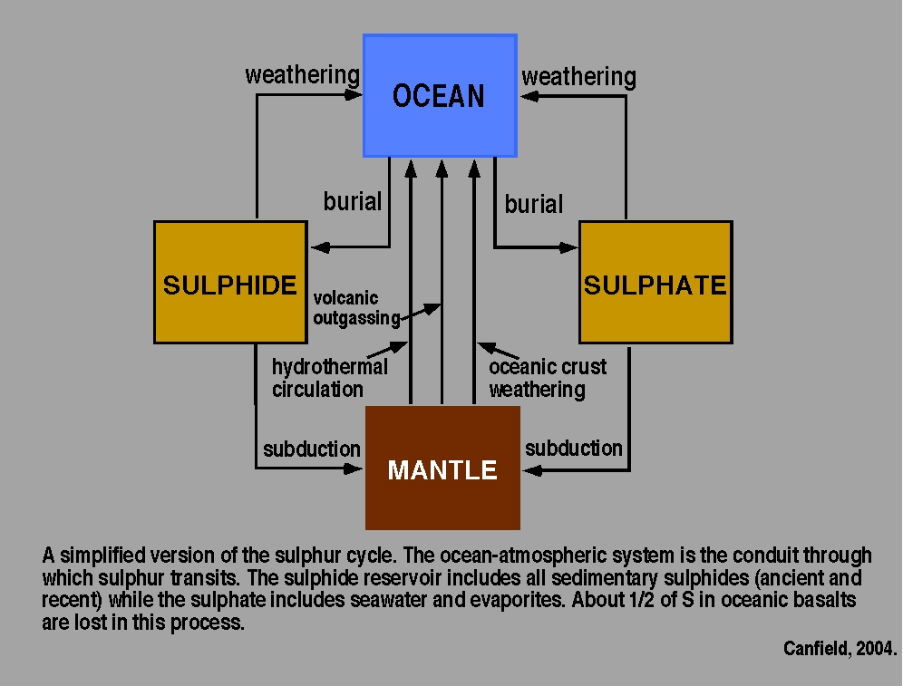

Slide 6
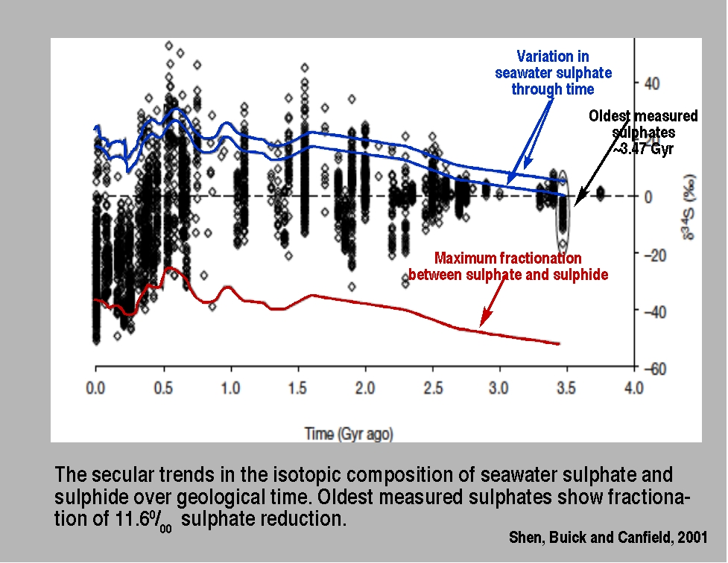

Slide 7
90% of S is dissolved
in oceans

Slide 8
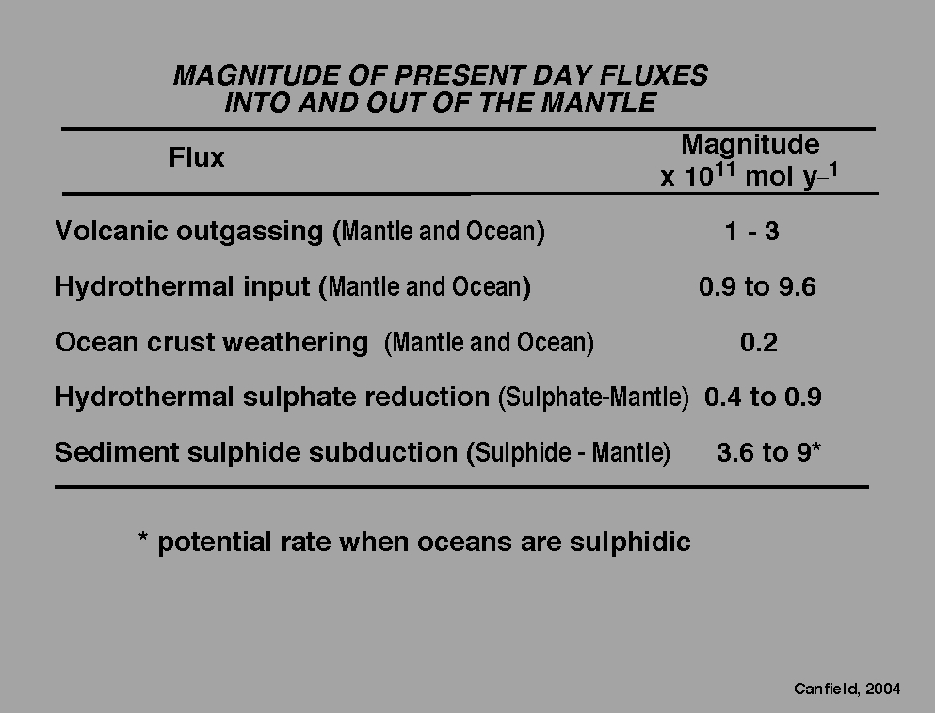

Slide 9
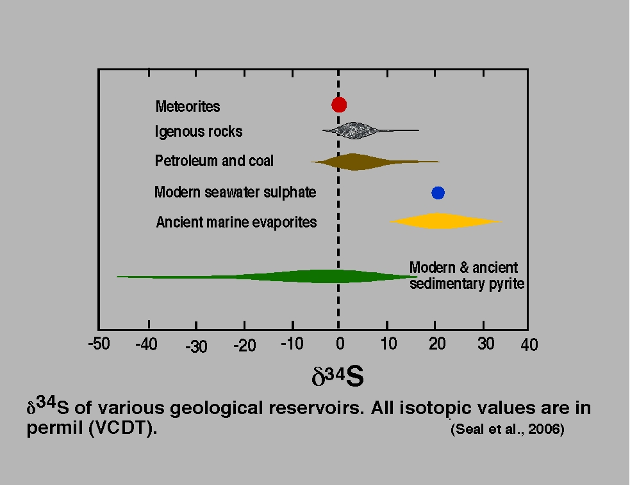

Slide 10
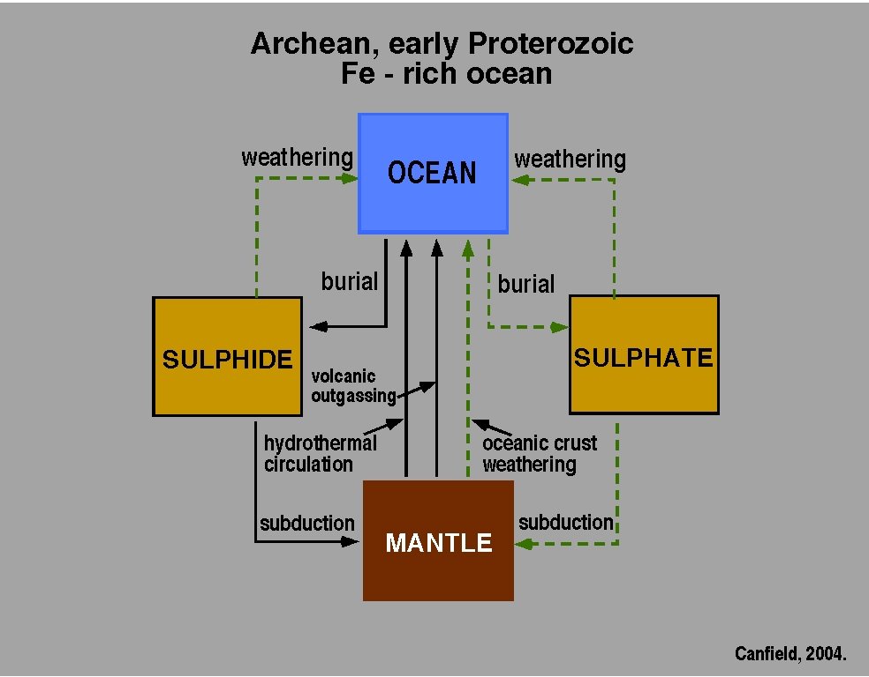

Slide 11
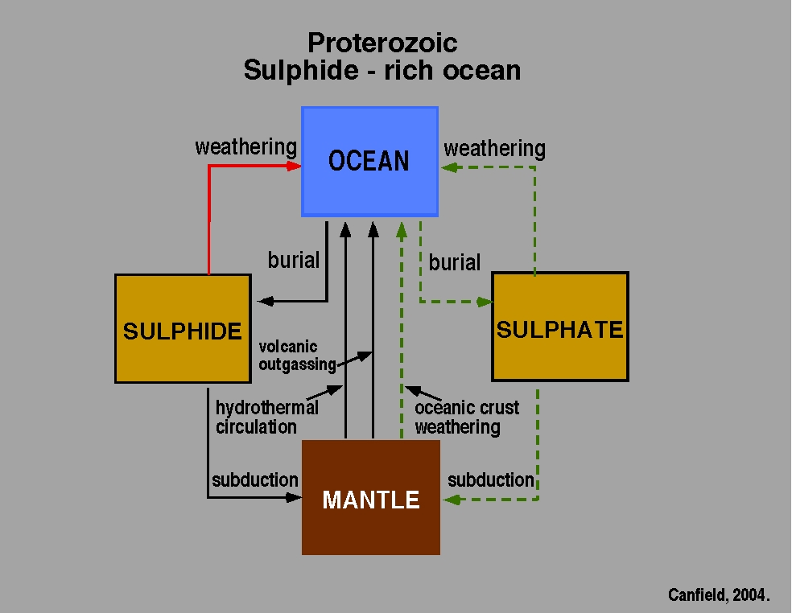
A

Slide 12
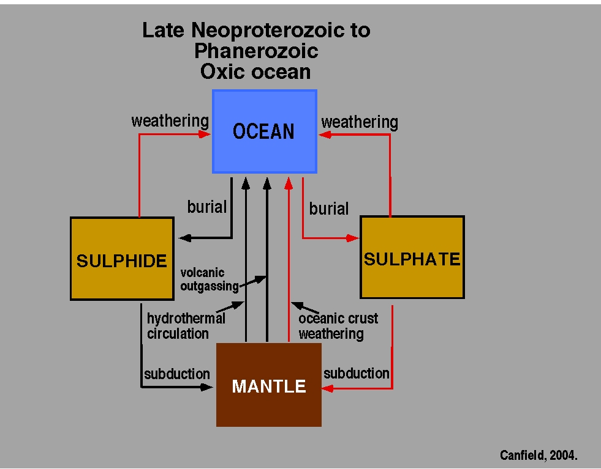
B

Slide 13
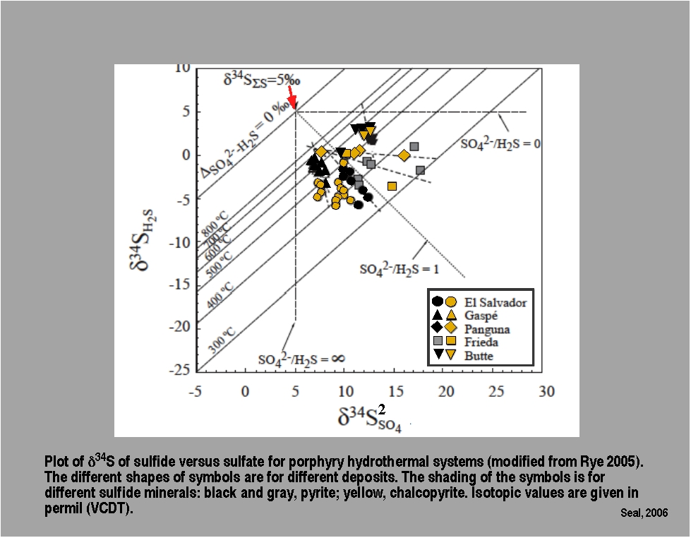

Slide 14
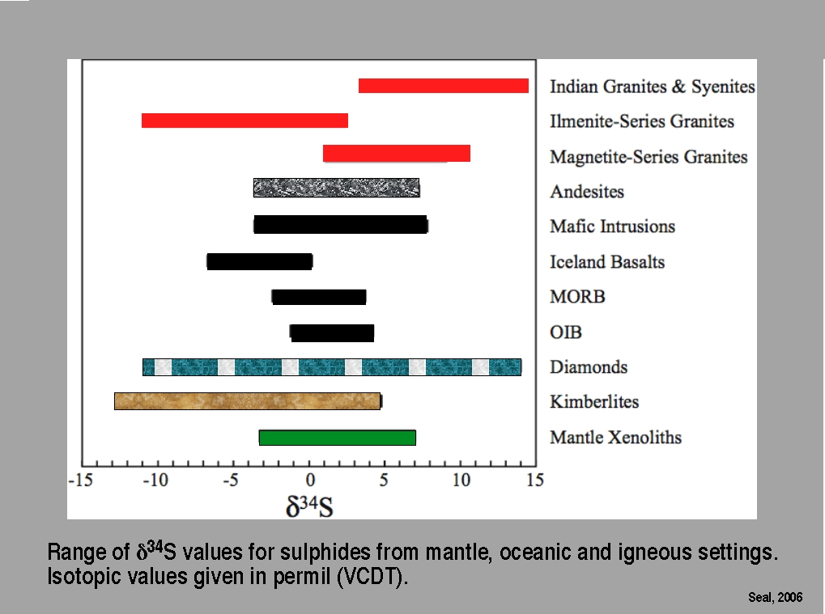

Slide 15
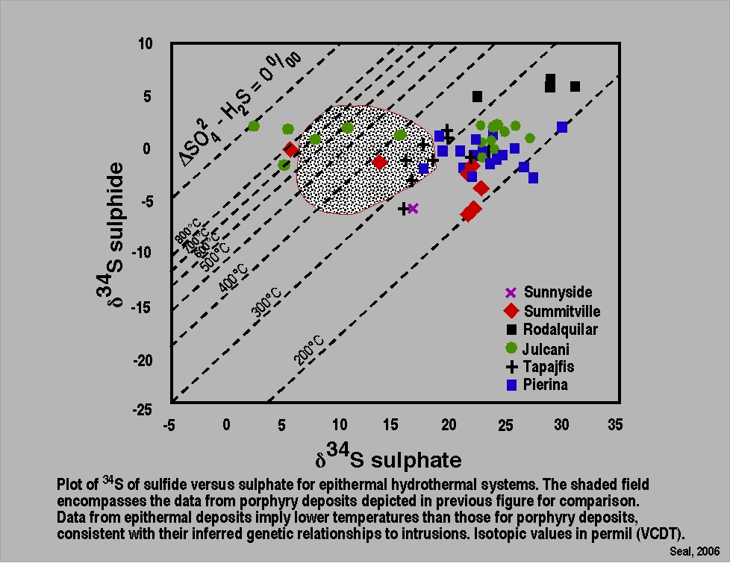
SHADED FIELD

Slide 16
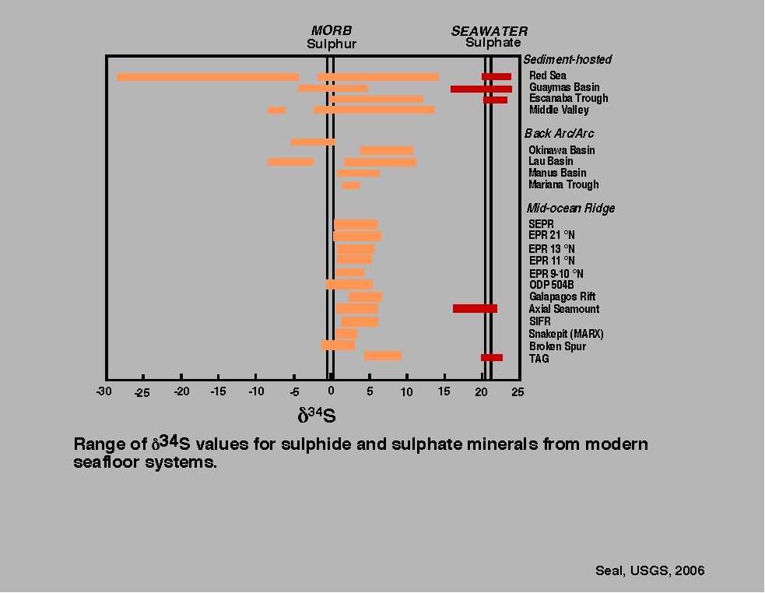
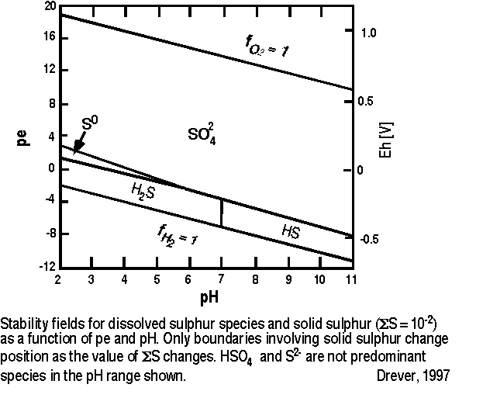

Slide 17
EARLIEST IDEAS FOR SULPHUR ACCUMULATION
SUGGESTED VOLCANIC ORIGINS
PARTICULARLY FROM STUDIES IN SICILY
WHERE M. ETNA IS EVER PRESENT
TYPE 1 SULPHUR

Slide 18
ETNA AND OTHER
IGNEOUS SULPHUR SOURCES CREATE A VERY
DIFFERENT ISOTOPIC ASSEMBLAGE FROM OTHER S
HOWEVER
GENERALLY MOST SICILIAN SULPHUR IS BIOGENIC
AND EXHIBITS THE ISOTOPIC VARIATIONS
CREATED BY THAT SOURCE.

Slide 19
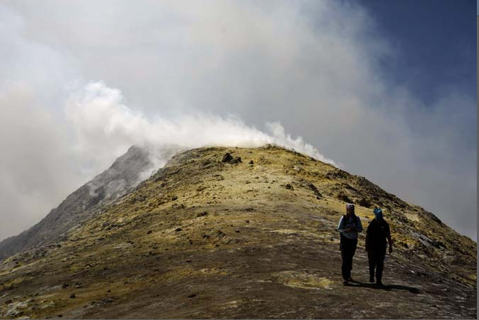
CREST OF MOUNT ETNA, SEPTEMBER 2008
TYPE 1 SULPHUR

Slide 20
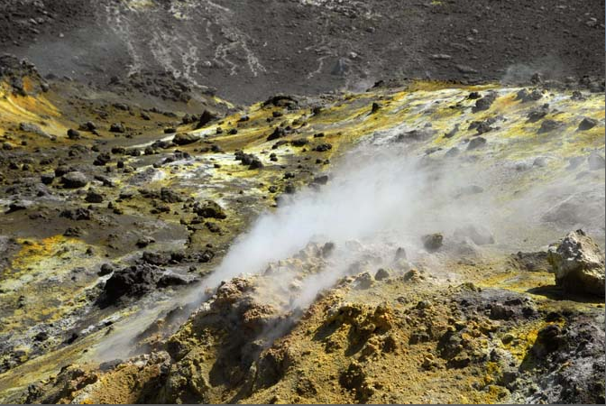
LOOKING INTO AN ACTIVE CRATER
NOTICE THE SULPHUR COATINGS!

Slide 21
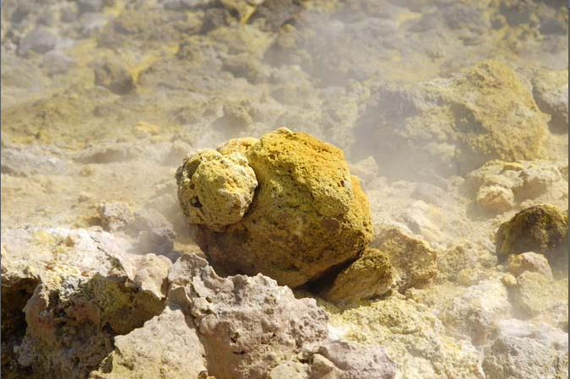
SULPHUR PRECIPITATES DIRECTLY ON ROCK SURFACES

Slide 23
The SO₂/H₂S ratio of gases emitted from
Mt. Etna varies and so does the sulphur
isotope value.

Slide 24
The SO₂/H₂S ratio of gases emitted from
Mt. Etna varies and so does the sulphur
isotope value.
WHY?

Slide 25
The SO₂/H₂S ratio of gases emitted from
Mt. Etna varies and so does the sulphur
isotope value.
WHY?
Part of the sulphur comes from the magma
source and part from the thermochemistry
developed as the magma passes through
the sedimentary section below the volcano.
THAT SECTION CONTAINS A GREAT DEAL OF
EVAPORATIVE, MARINE CaSO₄

Slide 26
“TYPE 2” SULPHUR
Bacterially produced by
breakdown of Ca sulphate,
in the presence of water
and organic matter
=
BIODEGRADATION

Slide 27
DEGREE OF ALTERATION IS
CONTROLLED BY COMPOSITION,
BEDDING, POROSITY,
ACCESS TO FLUID MIGRATION
BECAUSE
THE PROCESS REQUIRES BOTH
WATER AND ORGANIC MATTER
AS WELL AS A SULPHATE SOURCE

Slide 28
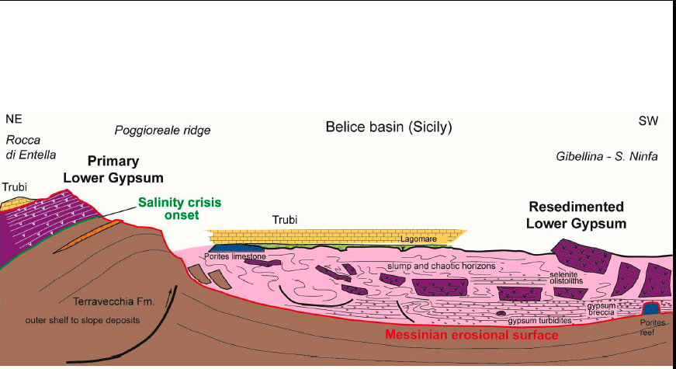
LOCATION IN SICILY
MOST SULPHUR DEPOSITS OCCUR IN BROKEN-BLOCKS OF
RESEDIMENTED MESSINIAN SEGMENTS PRESENT WITHIN
THE BASIN

Slide 29
In the Permian, Castile Formation, of
W.Texas/NewMexico, the section is also
broken - by faults. This also gives access
to water and hydrocarbons - necessary
for the bacterial activity.

Slide 30
BACTERIAL SULPHUR
FROM CENTRAL SICILY
(Cozzo Disi Mine)

Slide 31
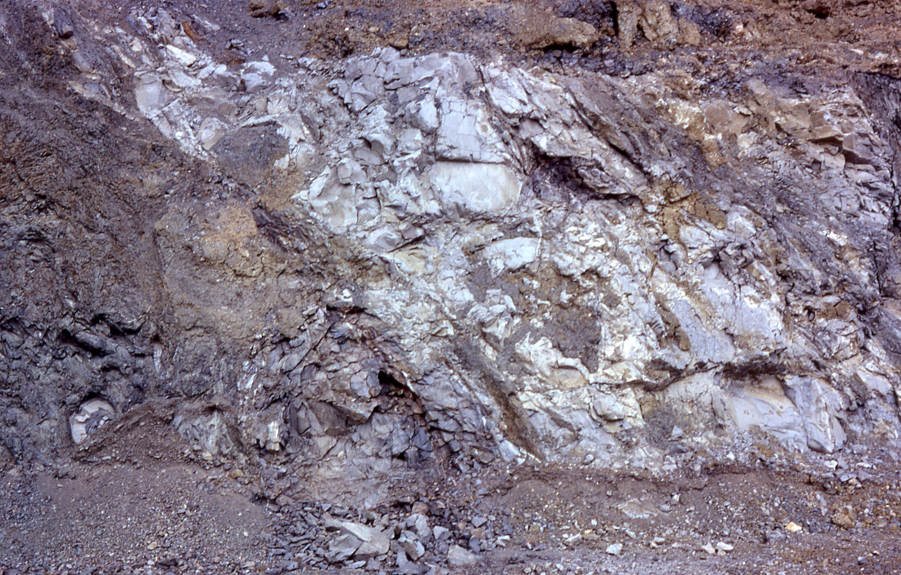
DIATOMITES-
JUST BELOW
COZZO DISI MINE

Slide 32
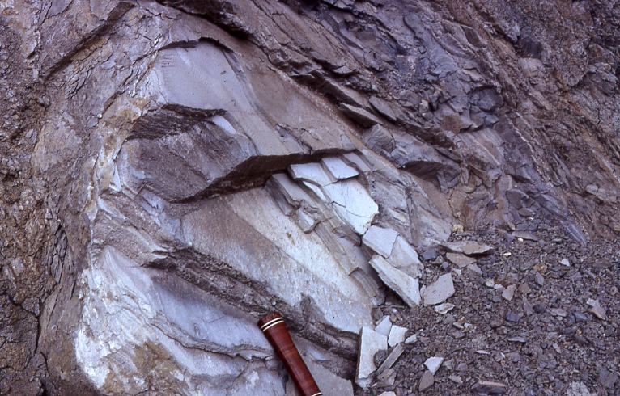
In Sicily:
Hydrocarbon source is probably from diatomites beneath the gypsum
sequence but also may arise from deeper underlying materials.

Slide 33
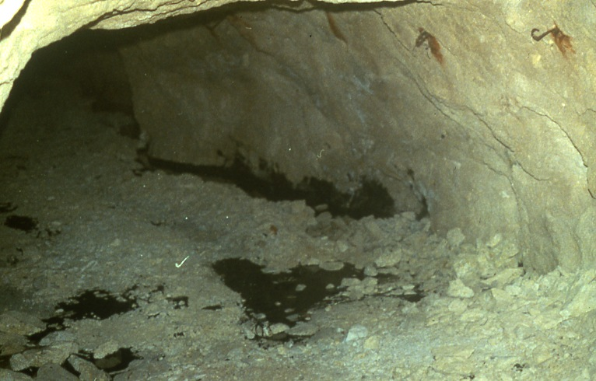
ENTRANCE TO COZZO DISI MINE, SICILY,
1984. NOTE OIL SEEPS AND POOLS.

Slide 34
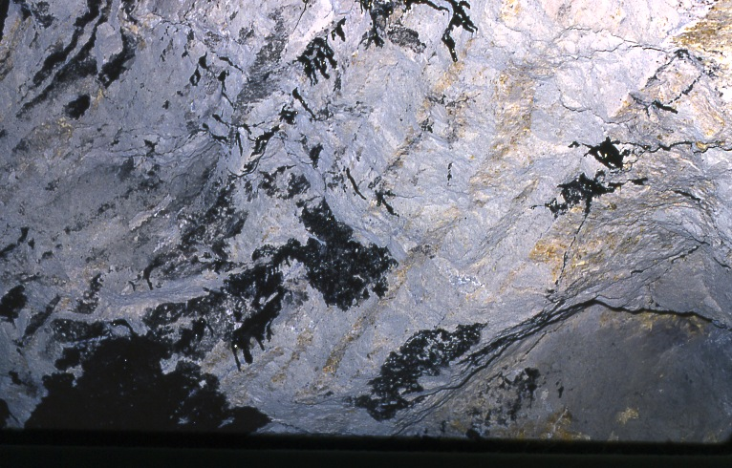
20 cm
THE OIL IS HIGHLY IMMATURE AND STRONGLY BIODEGRADED
(SEEPS FOLLOW POROSITY ALONG ORIGINAL BEDDING)

Slide 35
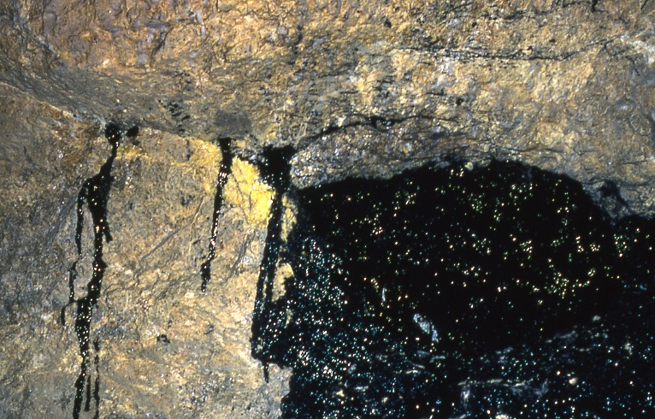
Active oil seeps in the Cozzo Disi Mine, Casteltermine, Sicily

Slide 36
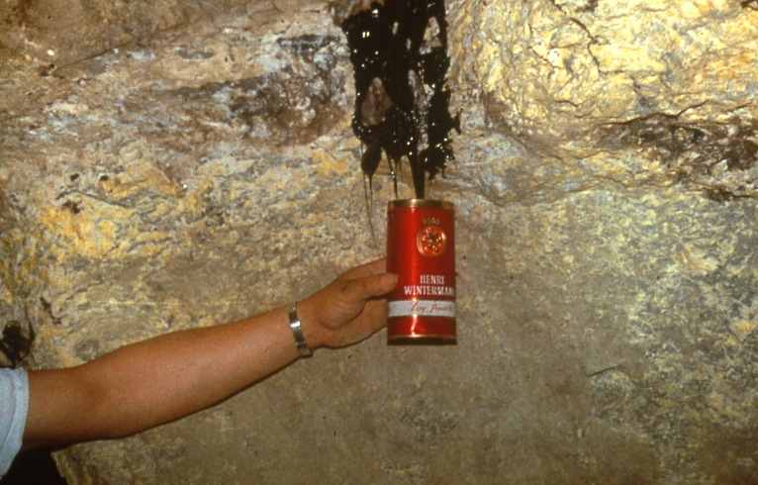
Casteltermine, Cozzo Disi Mine

Slide 37
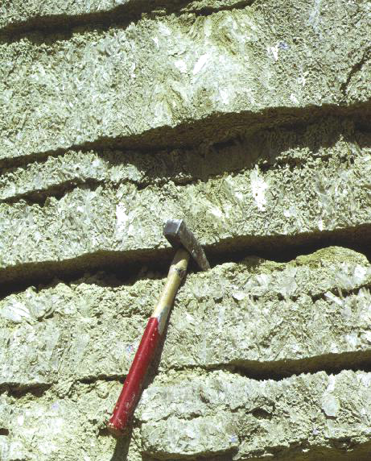
THICK BEDS
SHOWING
MORPHOLOGY
OF ORIGINAL
PRIMARY
GYPSUM,
WITH
WELL DEFINED
BEDDING AND
APPROXIMATELY
VERTICAL
CRYSTAL
ARRANGEMENT

Slide 38
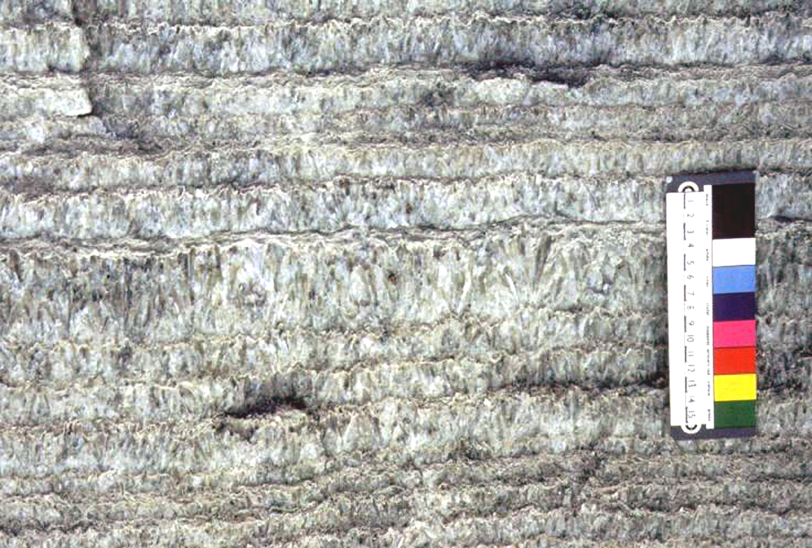
“BANDED” PRIMARY GYPSUM in THIN, REGULAR BEDDING
15 cm
“Banded“ gypsum, alternating with micritic microbial dolomite.

Slide 39
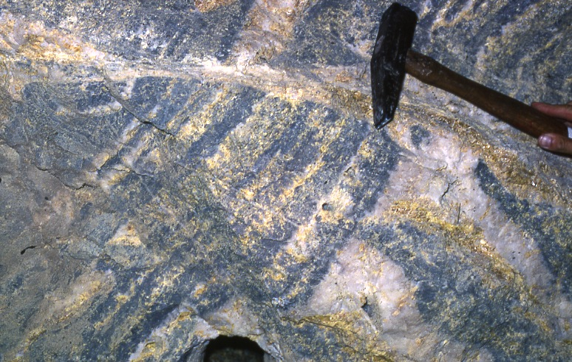
FRACTURE FILL
BEDDING
ANHYDRITE (after bedded gypsum), being altered
to sulphur. Dark gray is dolomitic carbonate, Cozzo Disi mine.

Slide 40
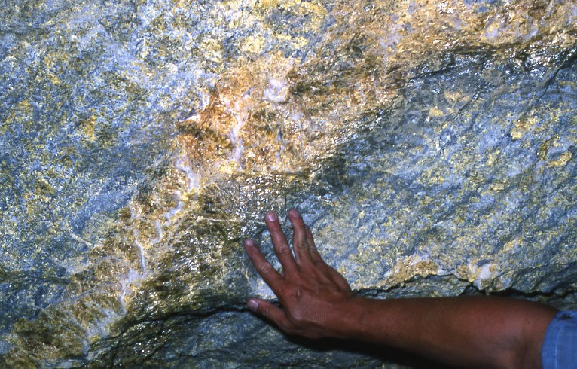
The thick gypsum bed is now composed of sulphur and aragonite

Slide 41
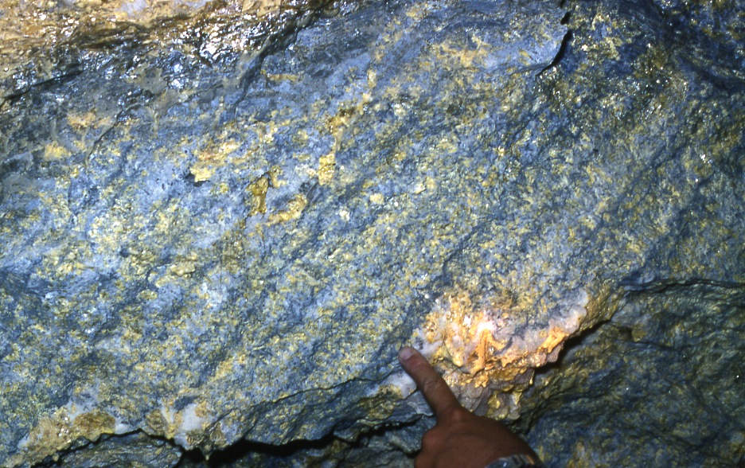
Relic of “banded” gypsum, dark grey is bacterial dolomicrite, white is massive replacive
aragonite with yellow sulphur.

Slide 42
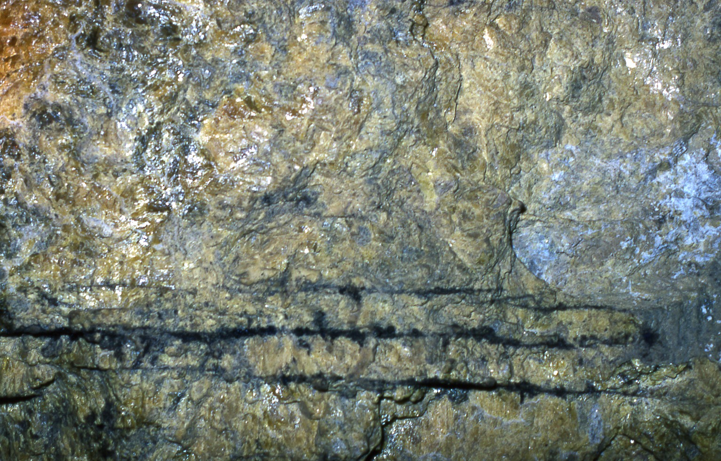
OIL SEEPS ALONG ORIGINAL BEDDING

Slide 43
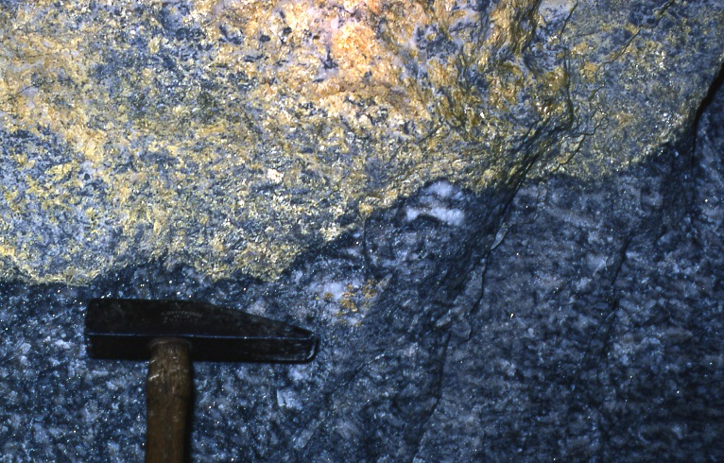
ALTERATION FRONT
bedding
Diagenetic front (at arrow) passing between anhydrite and
sulphur. Cozzo Disi, Sicily. NOTE BEDDING!

Slide 44
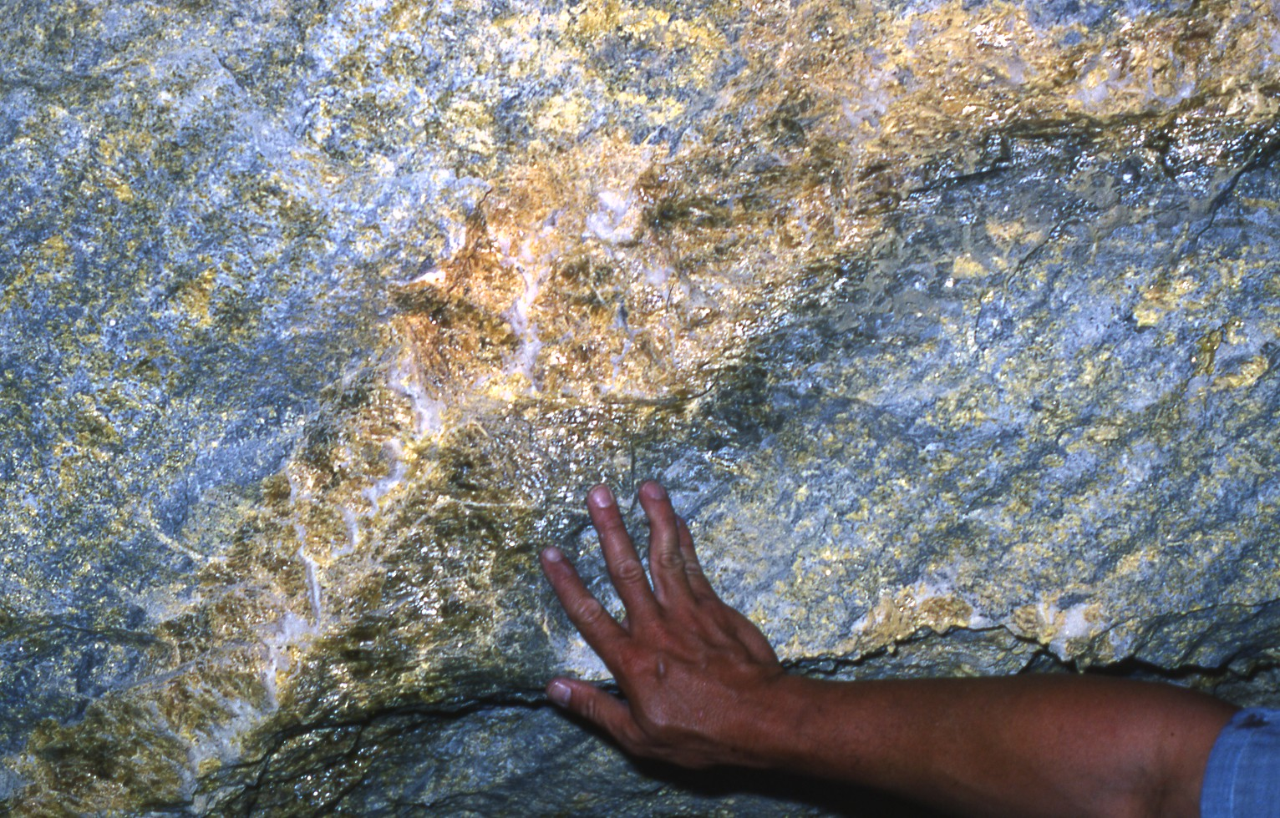
ORIGINALLY A MASSIVE SELENITE BED
COZZO DISI

Slide 45
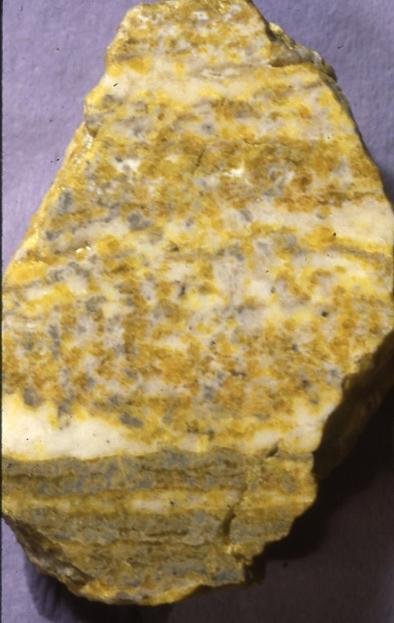
Hand sample of sulphur
+ secondary calcite or arag-
onite (white), maintaining
bedding and some of the
morphology of the original
gypsum .
Cozzo Disi, Casteltermine,
Sicily

Slide 46
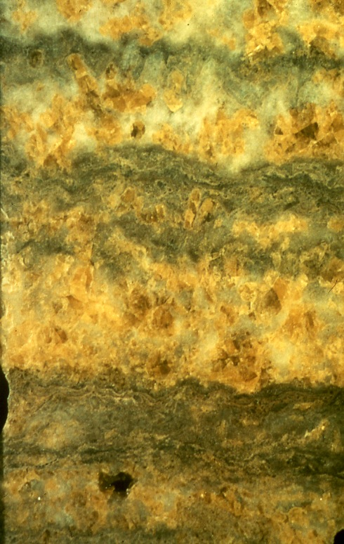
Original bedding and
crystal outlines
preserved by
dolomitic
microbialite
Intercalations
(Casteltermine, Sicily)

Slide 47
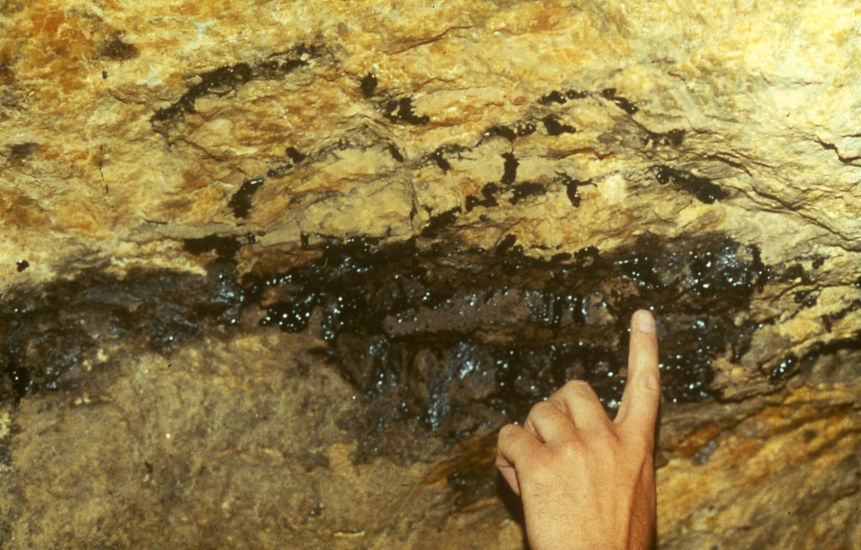
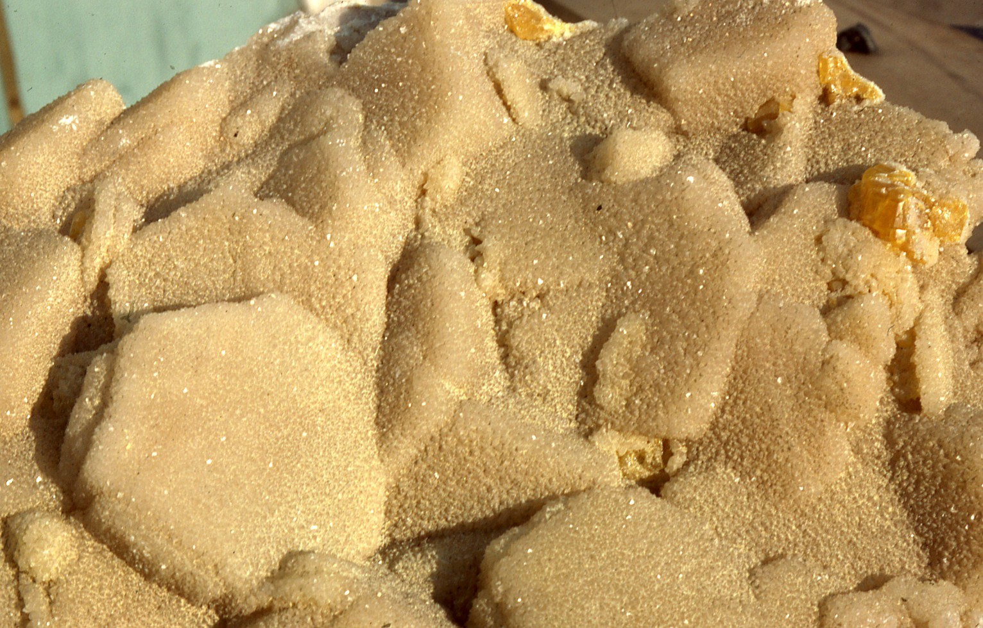
OIL SEEP
VOID FILLING IN SULPHUR MINES
SKELETAL - GROWTH OF
PSEUDOHEXAONAL
ARAGONITE
CRYSTALS-THESE CRYSTALS
ARE SKELETAL (HOLLOW)

Slide 48
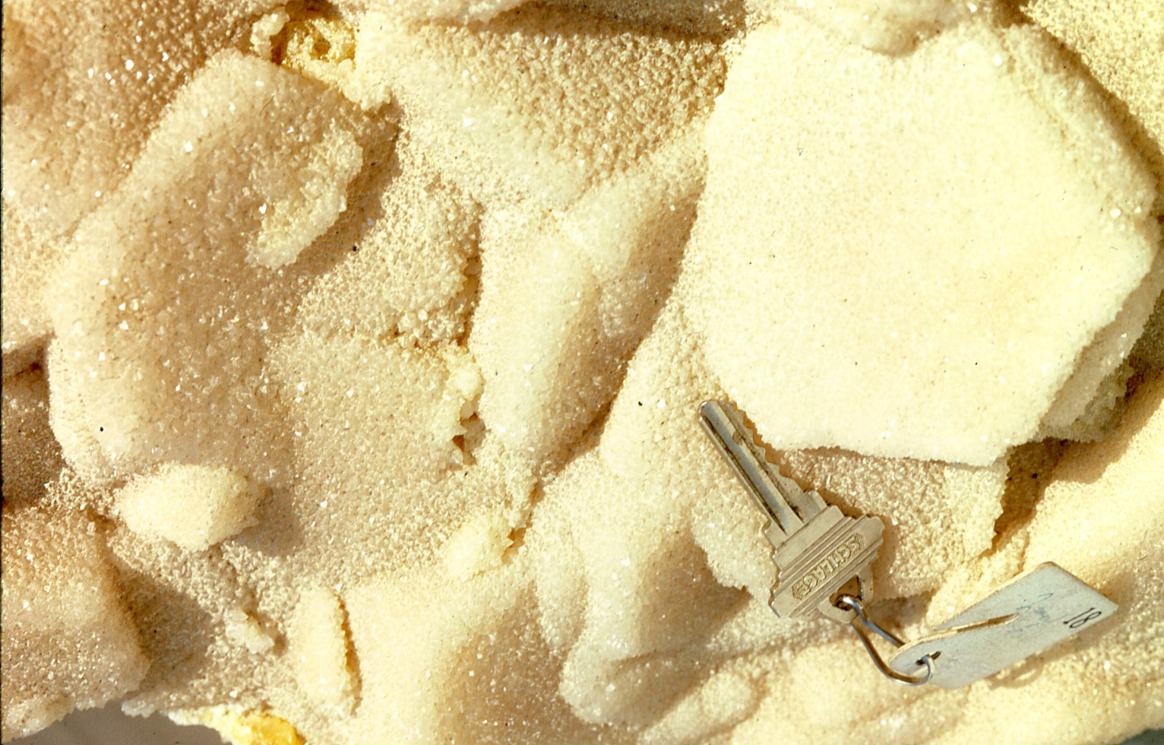
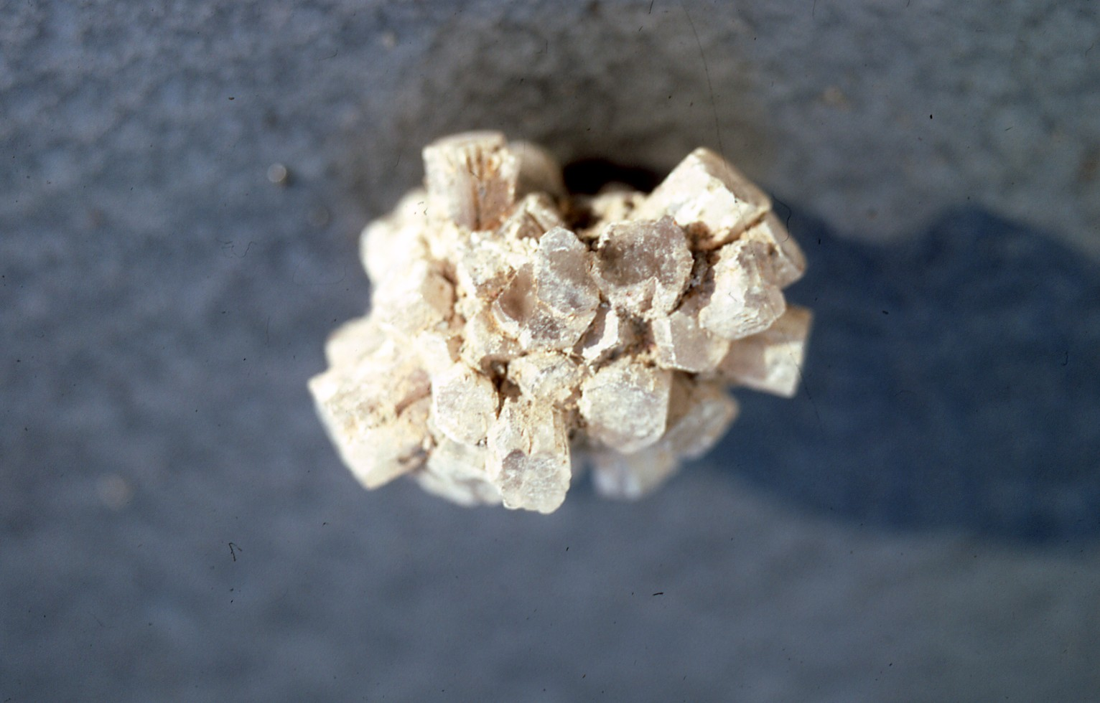
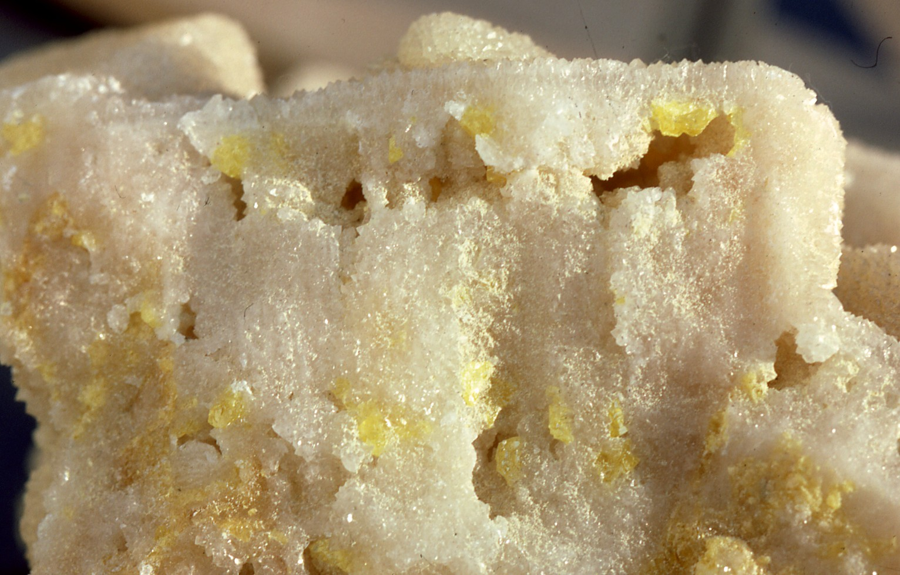
SKELETAL GROWTH OF
PSEUDOHEXAONAL
HOLLOW ARAGONITE
CRYSTALS
WITH S FILLING

Slide 49
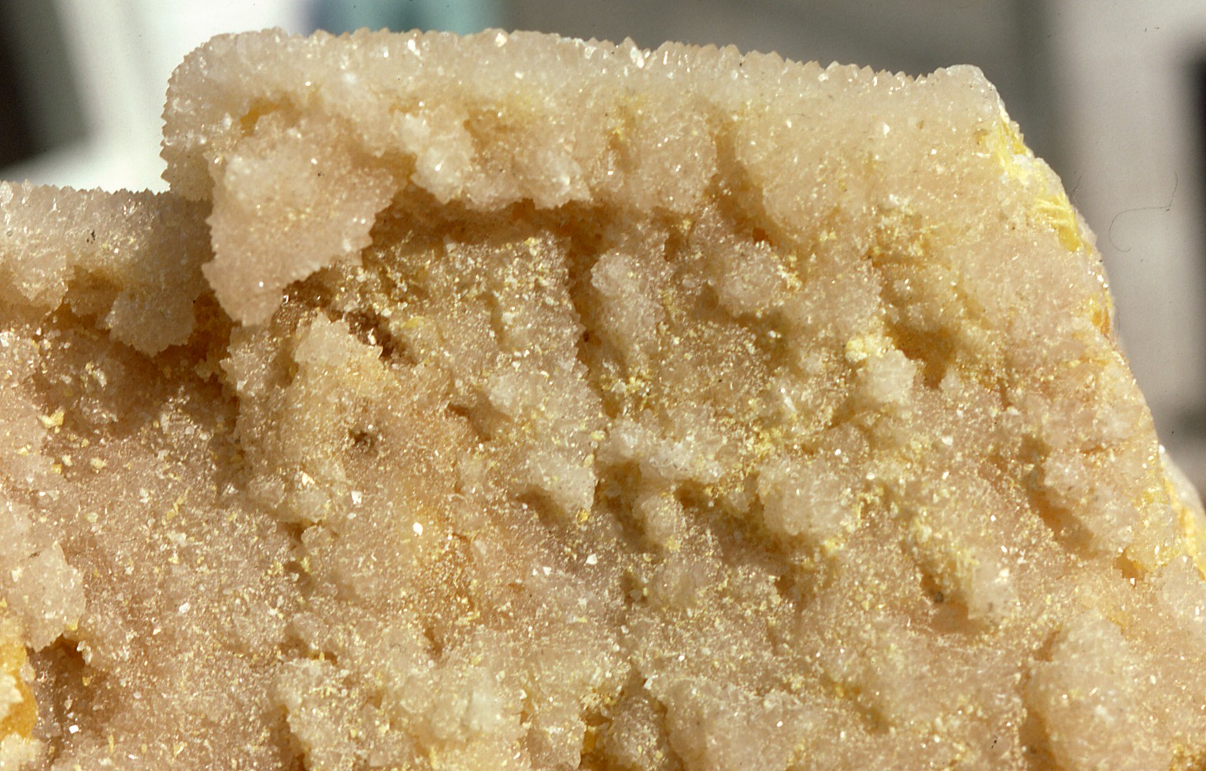
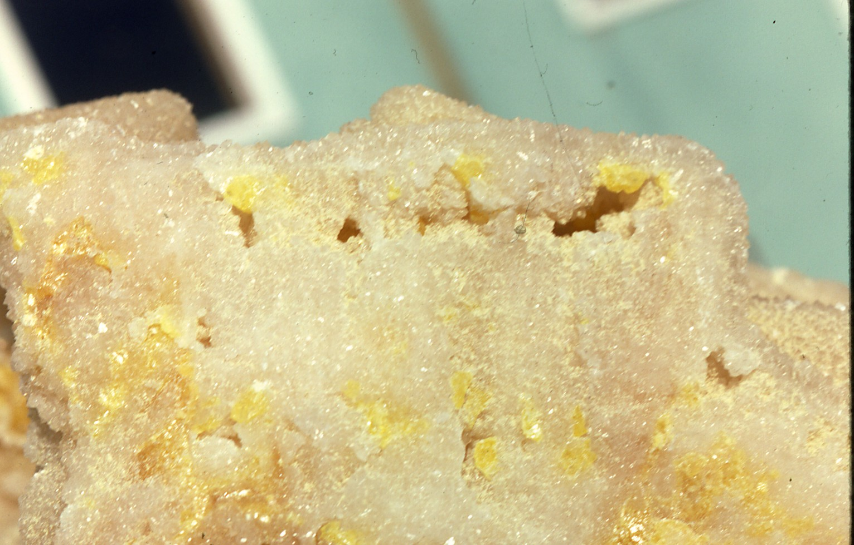
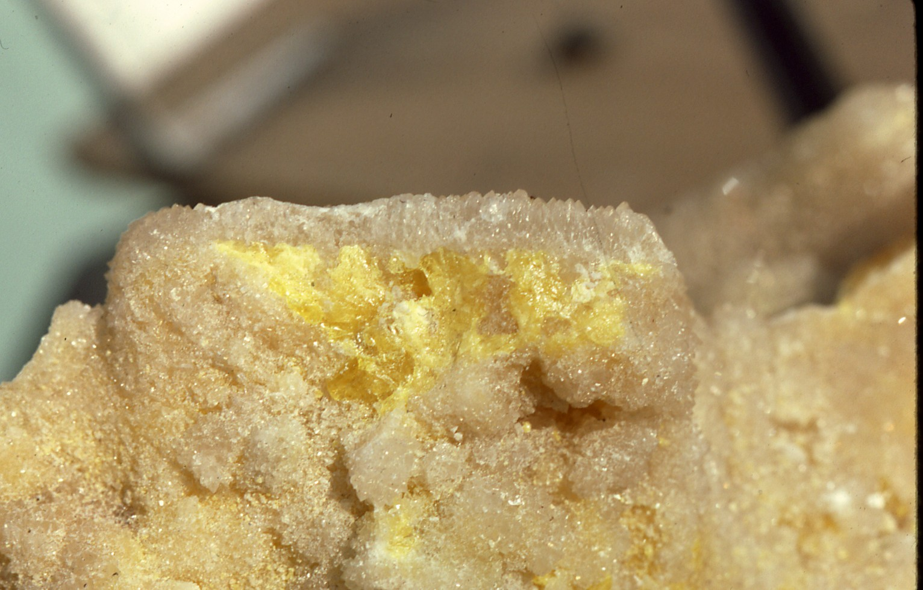
Skeletal crystals of aragonite

Slide 50
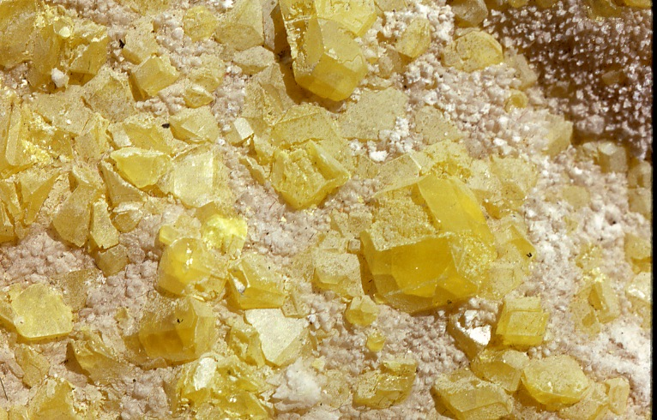
Sulphur and aragonite, produced by
biogenetic alteration of gypsum, growing in a void space.

Slide 51
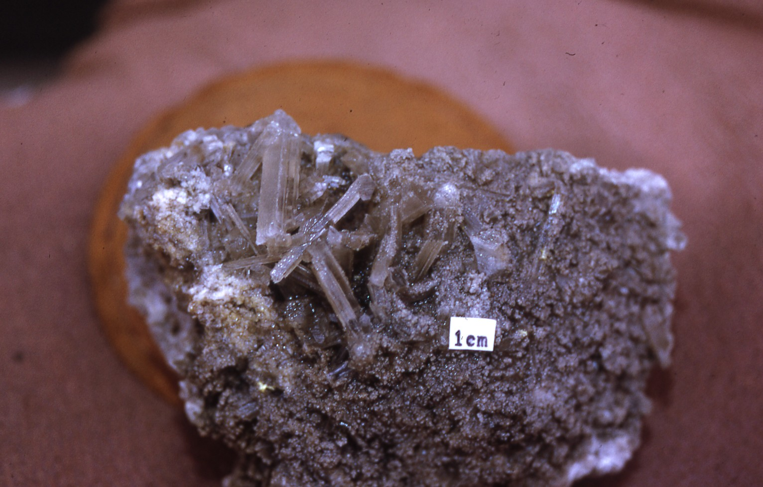
SECONDARY GYPSUM, FROM RECYCLED SULPHUR, NEAR SURFACE

Slide 52
KARST FILL SULPHUR
(another variatIon
but still bacterial)
Ciavolotta Mine, NE of Agrigento

Slide 53
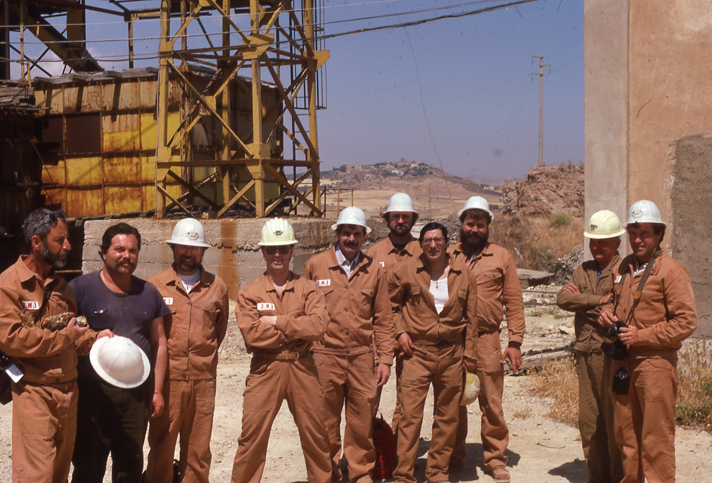
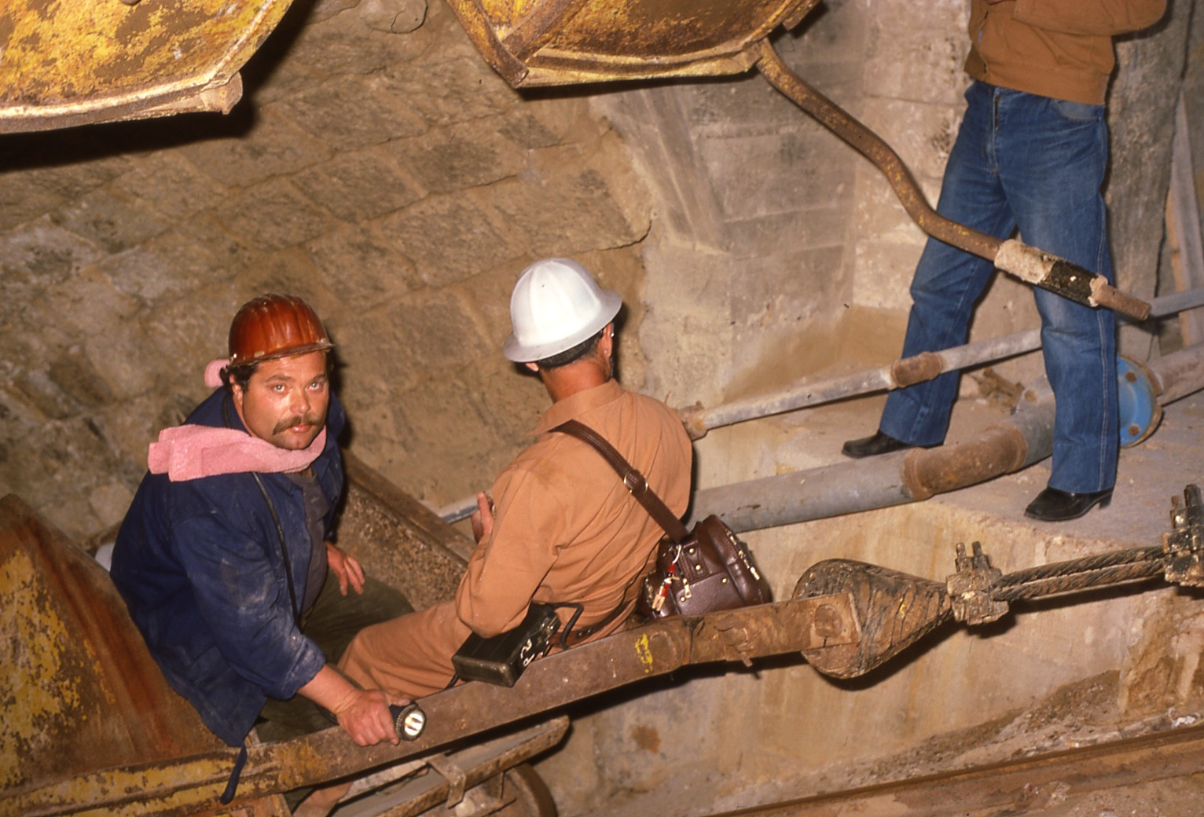
Ciavolotta Mine
The temperature wjthin the working
area of this mine was as warm
as 48 degrees C. Miners commonly
worked in their ‘skivvies’.

Slide 54
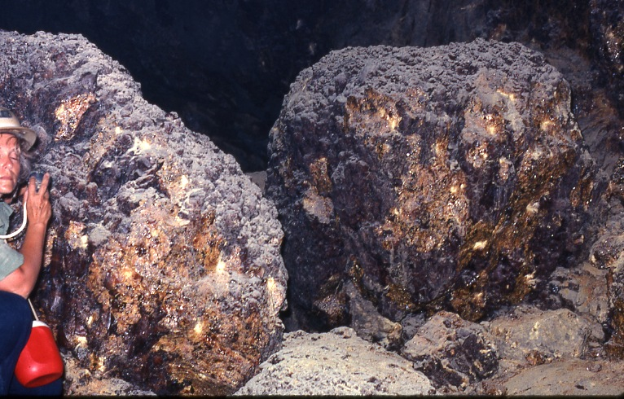
Sulphur formed in the upper part of a karstic sulphur mine.
Dark color possibly caused by accumulation of high-
temperature polymorph of S or else included hydrodrocarbon.
Ciavolotta Mine, NE of Agrigento

Slide 55
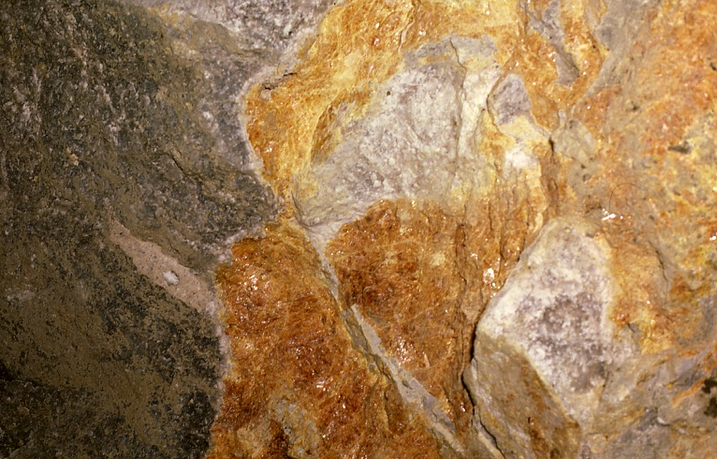
Amber-colored sulphur- Ciavolotta Mine
S polymorph (formed at elevated T).

Slide 56
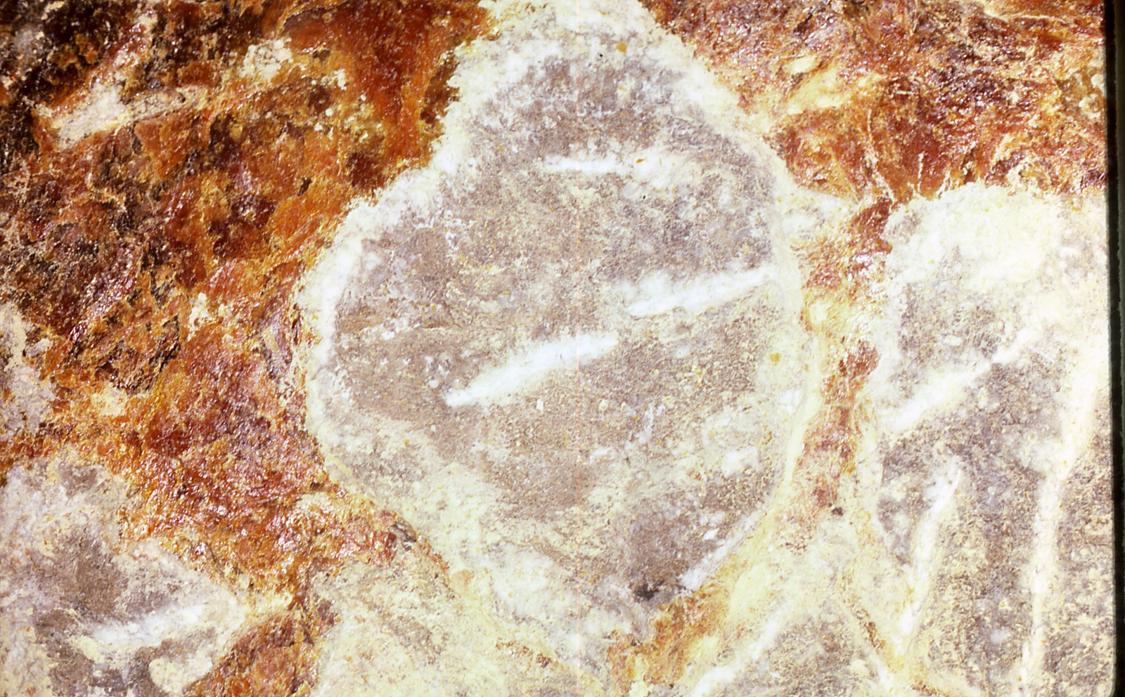
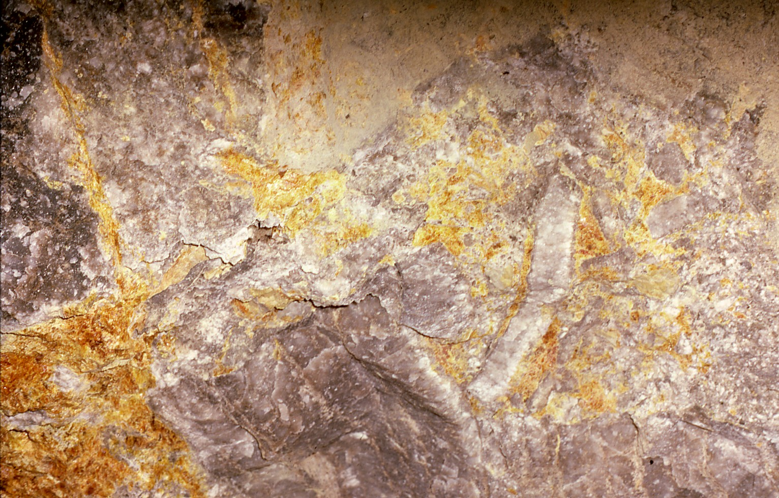
Ciavolotta Mine
White is finely crystalline
aragonite with a calcite rim.

Slide 57
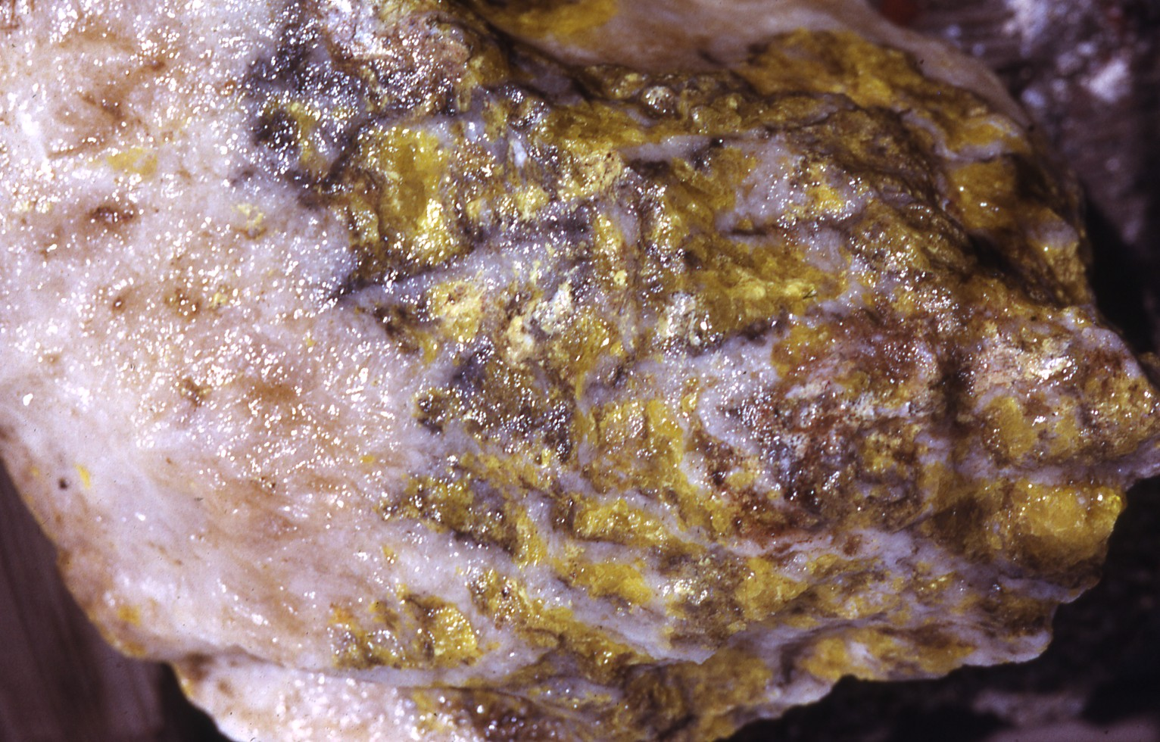
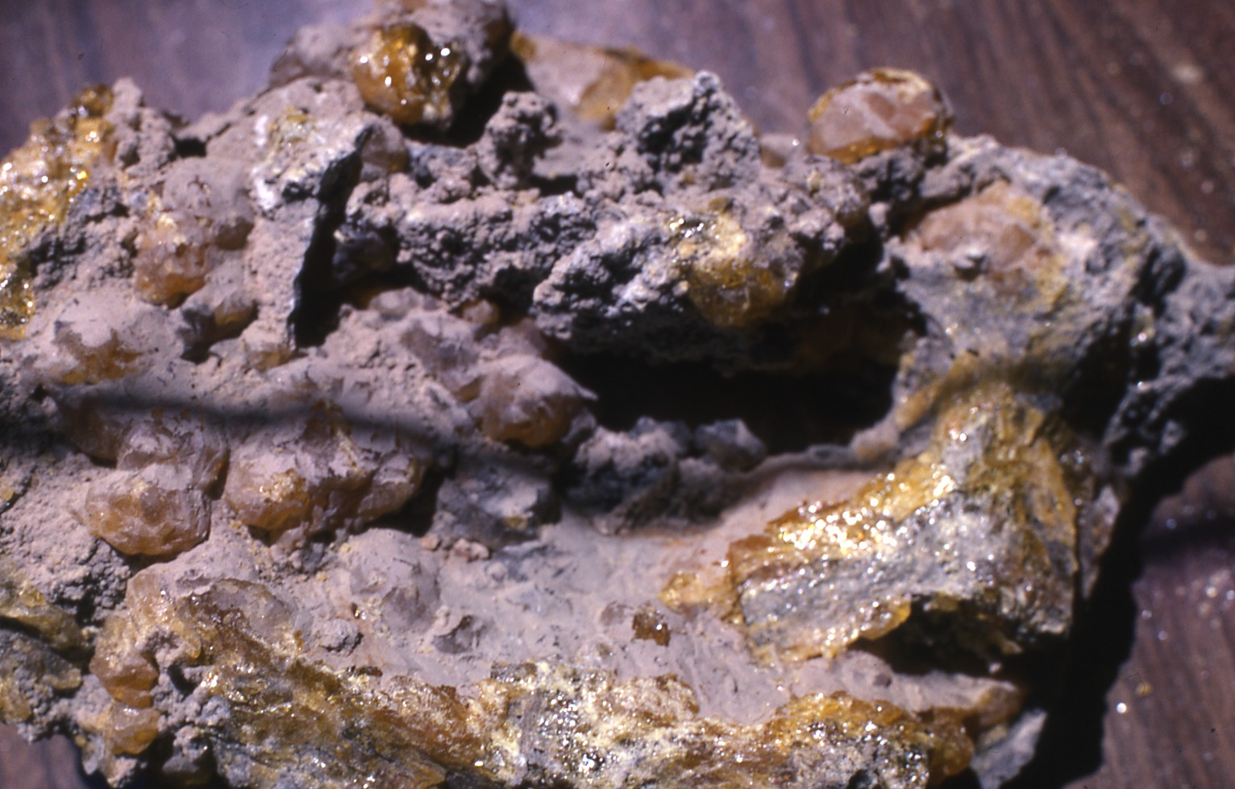
Ciavolotta Mine
Ciavolotta Mine

Slide 58


Slide 59

Ciavolotta Mine

Slide 60

Ciavolotta Mine

Slide 61
THERMOCHEMICAL SULPHUR

Slide 62
MOST SULPHUR IS FORMED BY
BACTERIAL SULPHATE REDUCTION-
BSR

Slide 63
BSR BEGINS IN DIAGENETIC SETTINGS
AT RELATIVELY LOW TEMPERATURES
FROM 0 TO 60-80 °C
ABOVE THESE TEMPERATURES THE
NORMAL RANGE OF BACTERIA
CEASE FUNCTIONING
AND
ONLY HYPERTHERMOPHILIC BACTERIA
ARE PRESENT
(SLOW GROWTH)

Slide 64


Slide 65
THERMOCHEMICAL SULPHUR FIRST APPEARS
AT TEMPERATURES ABOVE 80°C BUT IS MOST
COMMON BETWEEN 100 – 140°C.
IT IS APPARENTLY GOVERNED BY SEVERAL FACTORS;
ORGANIC REACTANTS, KINETIC CATALYSTS AND/OR
INHIBITORS, ANHYDRITE DISSOLUTION RATES,
WETTABILITY, AND MIGRATION/DIFFUSION RATES.

Slide 66
THE PRODUCTS OF BSR AND TSR ARE SIMILAR
THE PRIMARY INORGANIC REACTION PRODUCTS
ARE H₂S AND CO₂

Slide 67
ELEMENTAL SULPHUR USUALLY APPEARS
IN NOTABLE QUANTITIES WHEN THE SYSTEM
IS RUNNING OUT OF
REACTIVE HYDROCARBONS

Slide 68
THE PRIMARY INORGANIC REACTION PRODUCTS
IN BOTH THERMAL REGIMES ARE H₂S AND CO₂

Slide 69
THE PRIMARY INORGANIC REACTION PRODUCTS
IN BOTH THERMAL REGIMES ARE H₂S AND CO₂
THE PRIMARY MINERALS FORMED, IN THE PRESENCE
OF ALKALI EARTHS,
ARE CARBONATES (CALCITE AND DOLOMITE)
WITH MORE H₂S + OTHER IONS
IRON SULPHIDES, GALENA AND SPHALERITE FORM

